Slide 1
WEEK 1: WELCOME TO ART
Mrs. Allison Creasy

Slide 2
What will art look like virtually?
You will be given one PowerPoint each week. Within that PowerPoint will be the lesson/skills/vocabulary words to know for the week.
There will be a Jaguar Jumpstart to complete at the beginning of every class period.
You will have assignments to complete and you will take a picture of the assignments to upload into Google Classroom to be graded. ALL ASSIGNMENTS HAVE TO BE TURNED IN BY THURSDAY NIGHTS.
You will be quizzed on the vocabulary and skills from the week on FRIDAYS.
We will meet on Google Meets each day at the same time for instruction, questions, and help on class assignments.

Slide 3
About me:
From Jackson, TN
My husbands name is Hunter.
I have 2 sons, Hudson age 2 and Kenton 4 months.
Family is a big part of my life.
I love to hunt, fish and be outside.
Painting is my favorite medium of art.
I love to travel.
I have 2 dogs, Beezus and Ruby

Slide 4
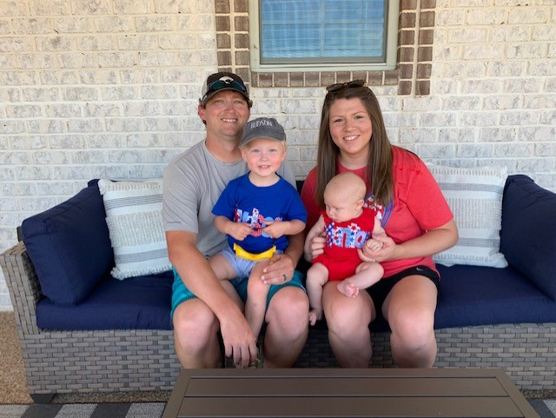
My Family:

Slide 5
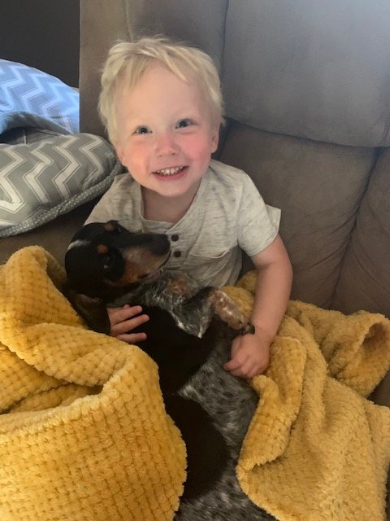
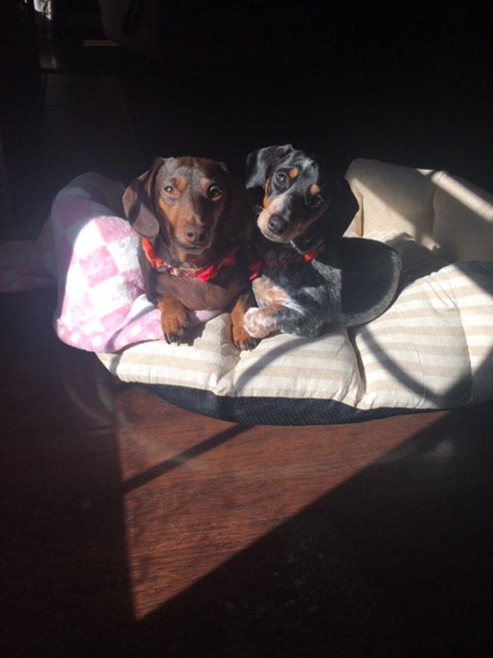
Hudson Brant
Kenton Allen
Beezus & Ruby

Slide 6
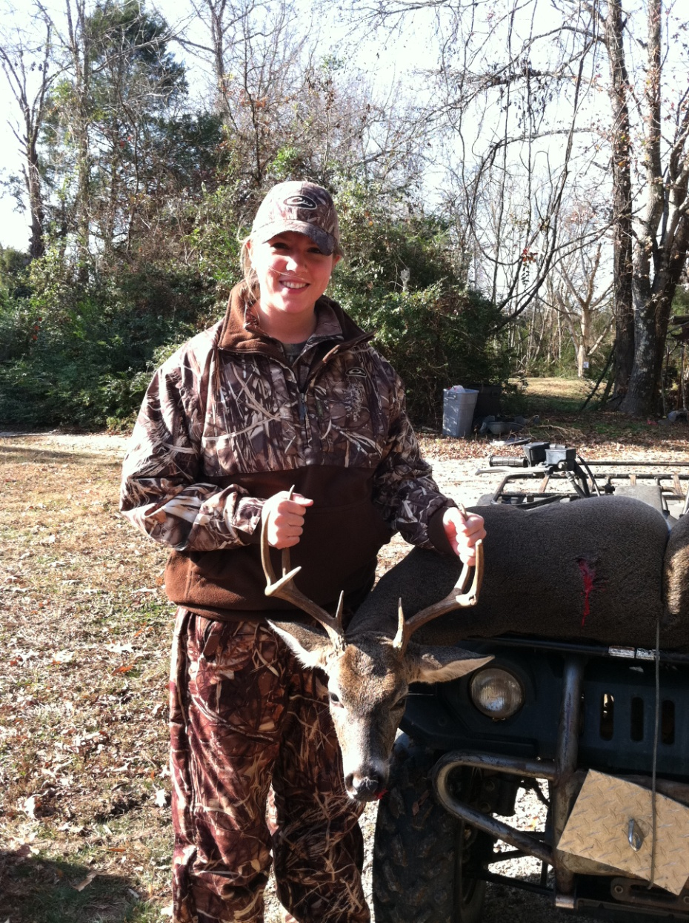
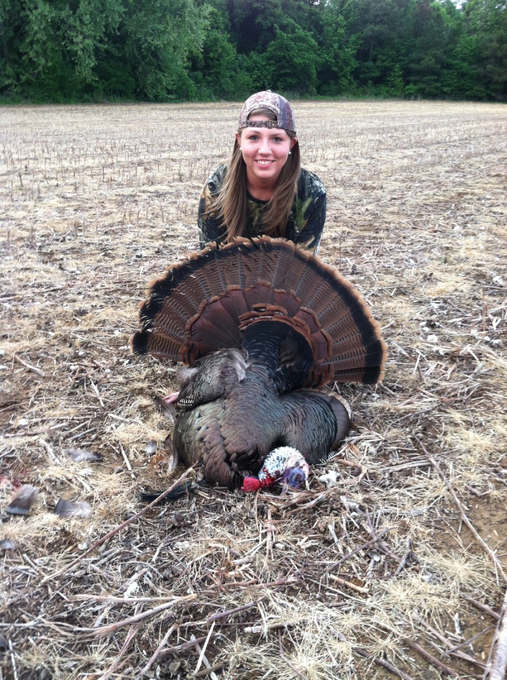
Hobbies

Slide 7
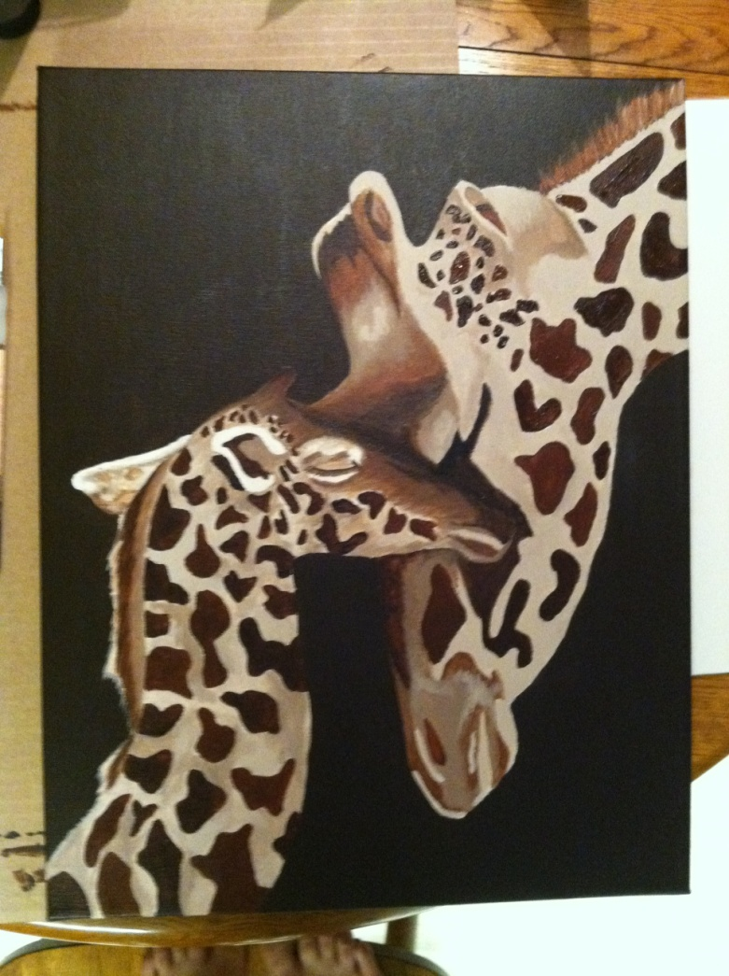
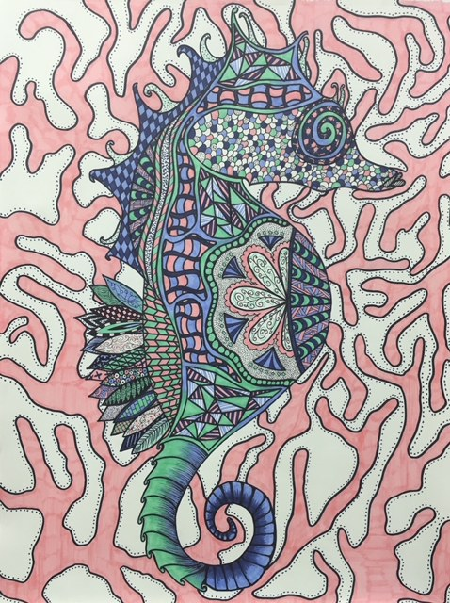
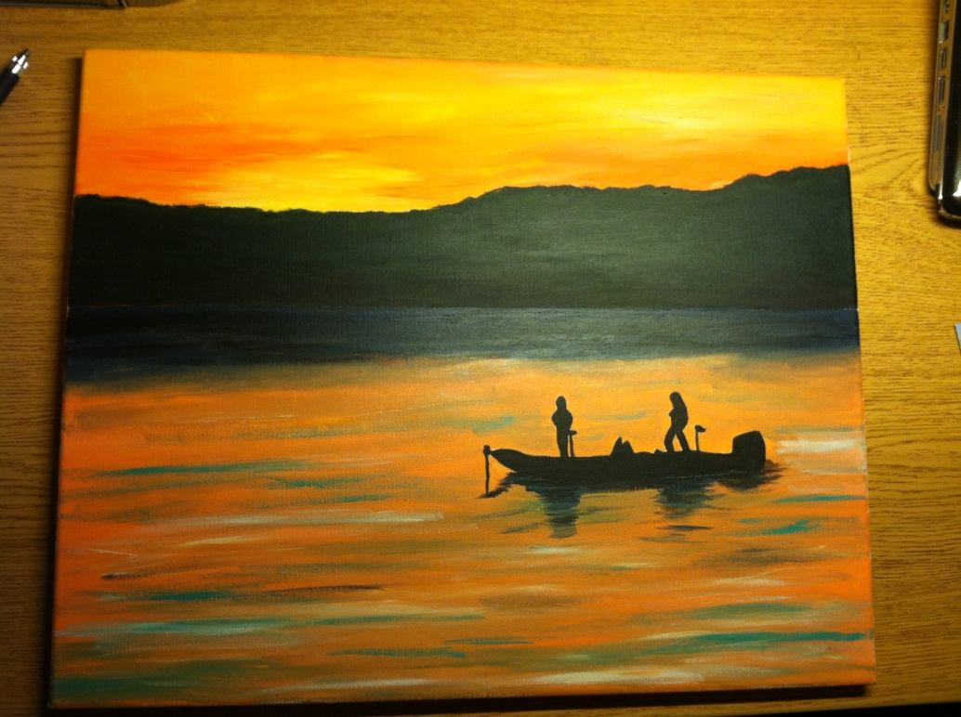
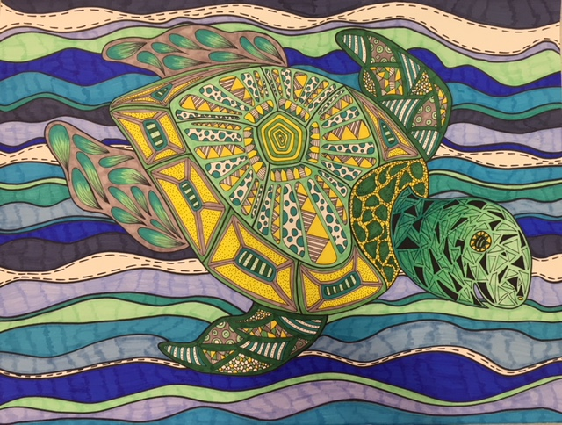
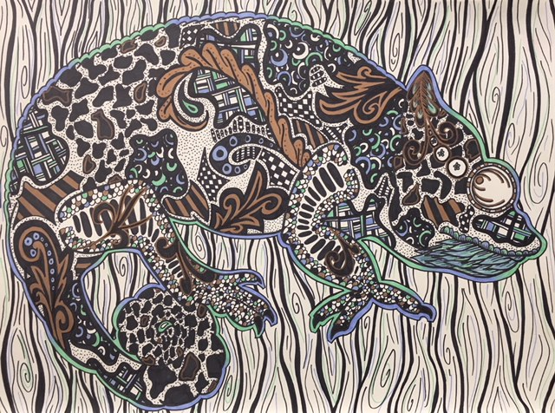
My Art

Slide 8
Art Expectations
This is NEW to EVERYONE! Please give me, yourself, parents and school some Grace.
All I expect from you is to try YOUR best.
Not everyone is fantastic at art. THAT IS OK!
This is a general art class that will teach vocabulary and simple skills. You are here to learn general art concepts to be able to expand upon that knowledge for later classes.
Art can be done with anything, anywhere! Do not limit yourself to just what you will learn in these 9 weeks. You can take what you learn here to practice on your own!

Slide 9
Art Elements
We will be looking at 1 of the 7 art elements each week for the next 7 weeks and week 9 will be a recap of all elements
Art Elements Overview Video

Slide 10
About Me Activity/Drawing
I want to see your best drawing and coloring skills! TRY YOUR BEST!!
On a sheet of notebook or copy paper create a 12 piece puzzle like here of things that describe you. In each piece you will need to complete the following topics by drawing images.
-My favorite sports team is…
-My favorite season is…
-In my free time I like to…
-My favorite food is…
-My favorite book is…
-My favorite type of music is…
-My least favorite food is…
-I am afraid of…
-My favorite animal is…
-My favorite movie is…
-My birthday is…
-I have this many siblings…
You will complete this, color it and upload the image into Google Classroom for a grade under the appropriate assignment link.

Slide 11
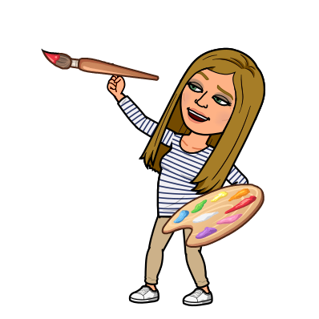
Mrs. Creasy’s Example
Use whatever you can find at home to make it your best!
-Use copy paper if you have it. If all you have is notebook paper, THAT IS OK!
-Please color if you have color pencils, markers, crayons or sharpies at home. If you do not have any of those send me an email to let me know and just use a pencil otherwise! IT IS OK! ☺

