Slide 1
Week 2: LINE
GRADED WORK FOR THIS LESSON
-Line Chart/Activity
-Contour Line Drawing
-Line Quiz

Slide 2
Objectives:
Identify five main kinds of line.
Identify kinds of lines in examples of art and photography.
Use five kinds of lines in a line chart.
Create a contour line drawing.
Evaluate student work.

Slide 3
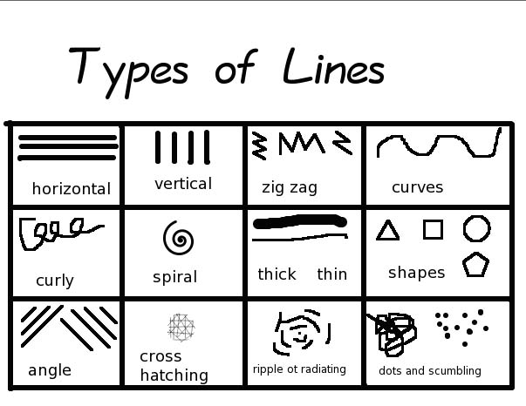
Types of Line

Slide 4
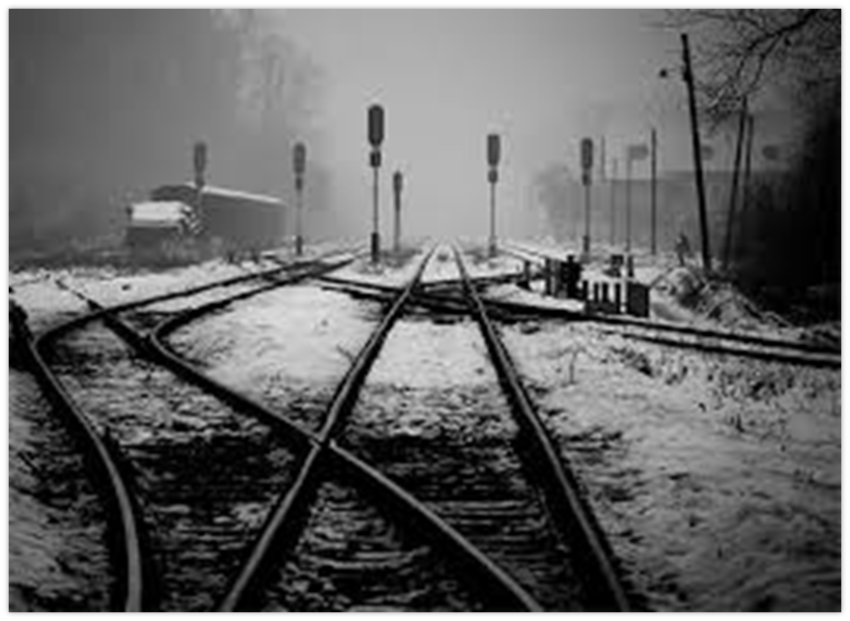
Please find the 5 different types of lines in these 4 images.

Slide 5
Line Chart Activity
Take a sheet of paper (copy or notebook paper) and create 5 sections. Label each section with one of the 5 types of lines. In the different sections draw 3 real world examples of that specific type of line. You may draw with pencil. If you would like to color your images you can, but are not required to.
You will take a picture of this activity to upload into Google Classroom under the LINE CHART ACTIVITY.
Example: Vertical (Flagpole, a person standing, pasta box)
Example: Horizontal (Car, snake, someone swimming)
Example: Diagonal (a plane taking off, a ladder leaning against a building, rain falling)
Example: Curved (snail, curly hair, taco)
Example: ZigZag (lightening, mountains, scissors)

Slide 6
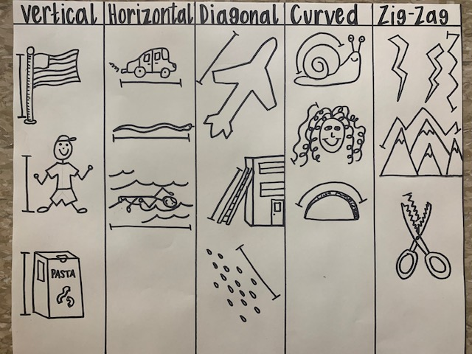
Line Chart Activity Example

Slide 7
Contour Line Drawings

Slide 8
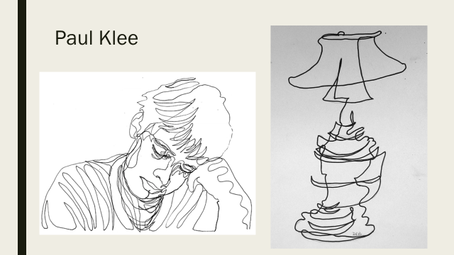
Artist Examples of Contour Drawings

Slide 9
Create your own Contour Line Drawing of ONE Shoe of your choice.
CLICK THE BUTTON TO SEE A HOW TO DRAW VIDEO OF A CONTOUR LINE SHOE DRAWING
You may use copy paper or notebook paper. You must draw ONE of your shoes from the SIDE view. Your goal is to try to draw it as realistically and to the correct life-like size as you can. You are to only draw the lines you see like shown here.
You will take a picture of this activity to upload into Google Classroom under the Contour Line Drawing Activity.

Slide 10
Mrs. Creasy’s Contour Shoe Drawing Example:

Slide 11
Line Quiz
Your line quiz will be uploaded into Google Classroom Week 2: Line to complete for a grade once you have completed both of the line activities by Friday.

