Slide 1
Week 3: Value
Graded work for this lesson:
-Value Scale Chart/Activity (Gray and Color) Submit a picture
-Value Drawing using things found in the kitchen Submit a picture
- Value Quiz

Slide 2
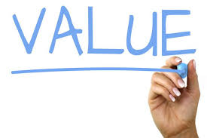
VALUE
Value is a basic element of art that refers to the gradual change of lightness or darkness of a color. It is created when a light source shines upon an object creating highlights, form shadows and cast shadows.
Tint: A light value of a color; made by adding white.
Shade: A dark value of a color; made by adding black.

Slide 3
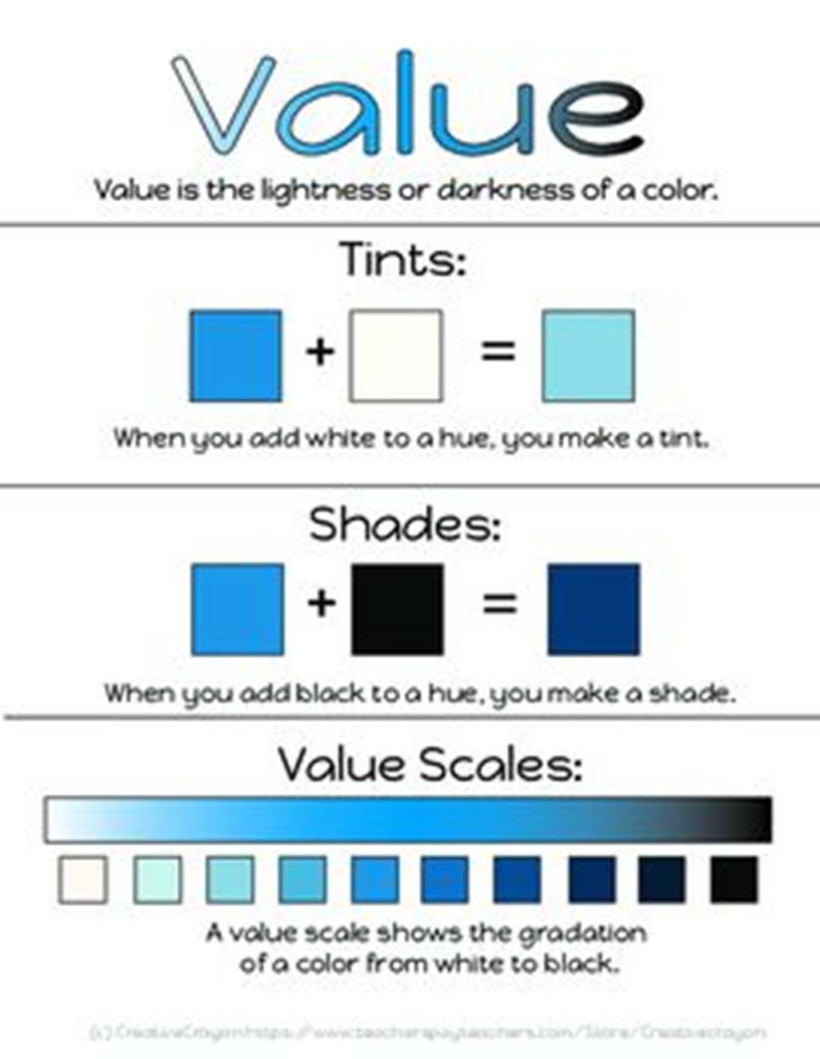
Gray and Color value

Slide 4
Gray and Colored Value Scale Activity (Graded)
Practice!
Using this Value Scales page on the right you will create a Pencil and 3 colored pencil value scales. Draw the Pencils like shown in the same order. Follow the instructions with how much pressure you apply to the pencil. For the colored pencil drawings you need to use 1. Red. 2. Blue. 3. Yellow.
Upload in to the Google Classroom assignment when you have completed the work.

Slide 5
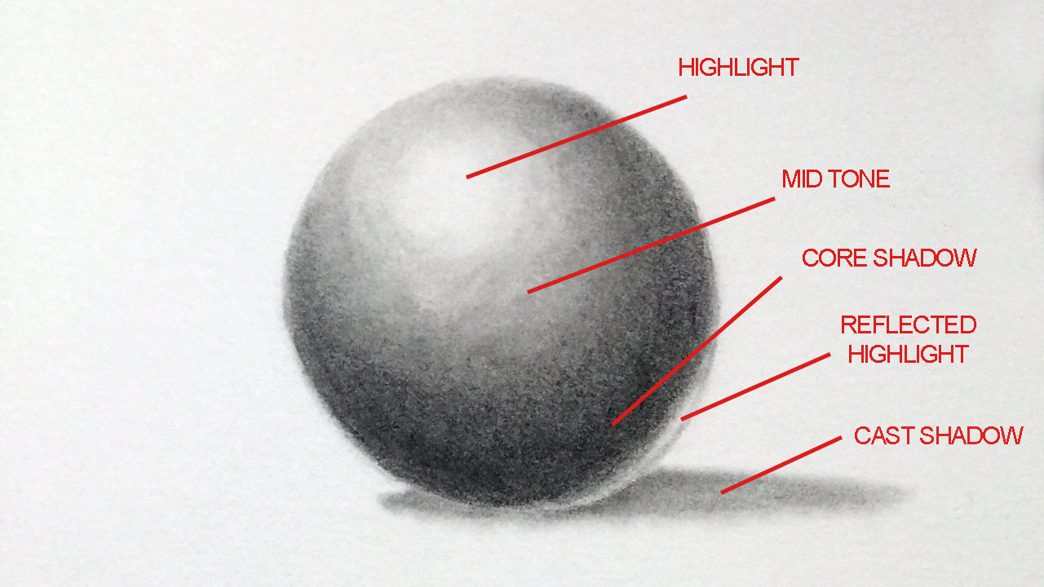
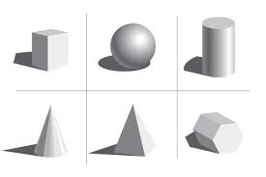
5 Steps of a Blended Form.
Practice this on your own with these 6 forms.

Slide 6
5 methods of shading: -Hatch -Cross hatching -stipple -marks (stumping) -Blending

Slide 7
Practice these 4 methods of shading

Slide 8
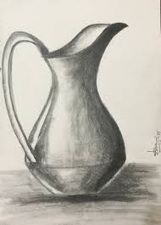
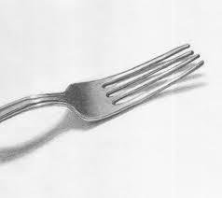
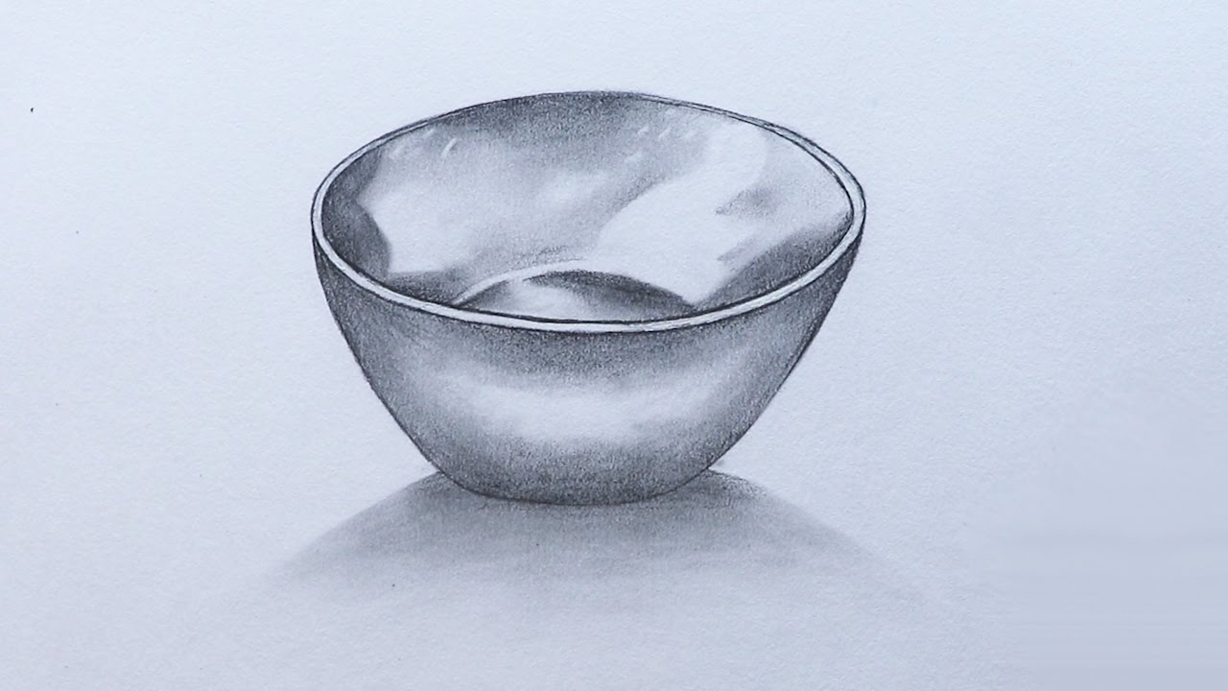
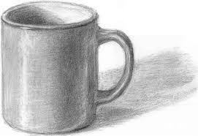
Value drawing of things found in the kitchen
Using the shading techniques you have learned, find 3 things in your kitchen you want to try to draw and shade. (fork, spoon, cup, plate, bowl, pitcher, vase, appliance, etc)
Draw each one on its own separate piece of paper.
You will submit each drawing into Google Classroom. There will be a place to upload each image separately. MAKE SURE YOU DO ALL THREE!!

Slide 9
Friday
Value QUIZ!!!!

